Slide 1

SonarQube
Setting up NodeJs Project Jenkins & SonarQube
Presented By :
Amrit Choudhary

Slide 2
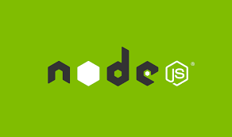
On boarding NodeJsprojects
Pre- Requisites
No Pre-Requisites

Slide 3
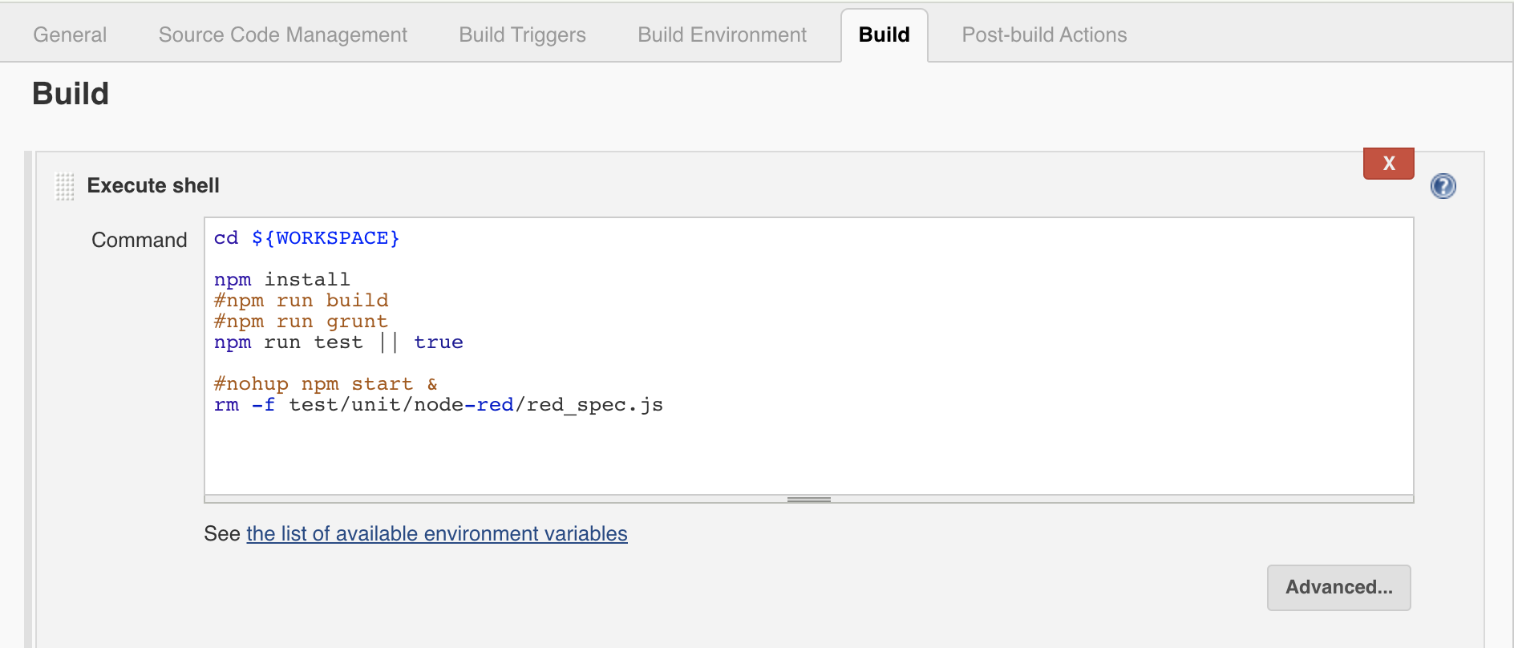
On boarding NodeJs project on Jenkins Sonar Scanner

Slide 4
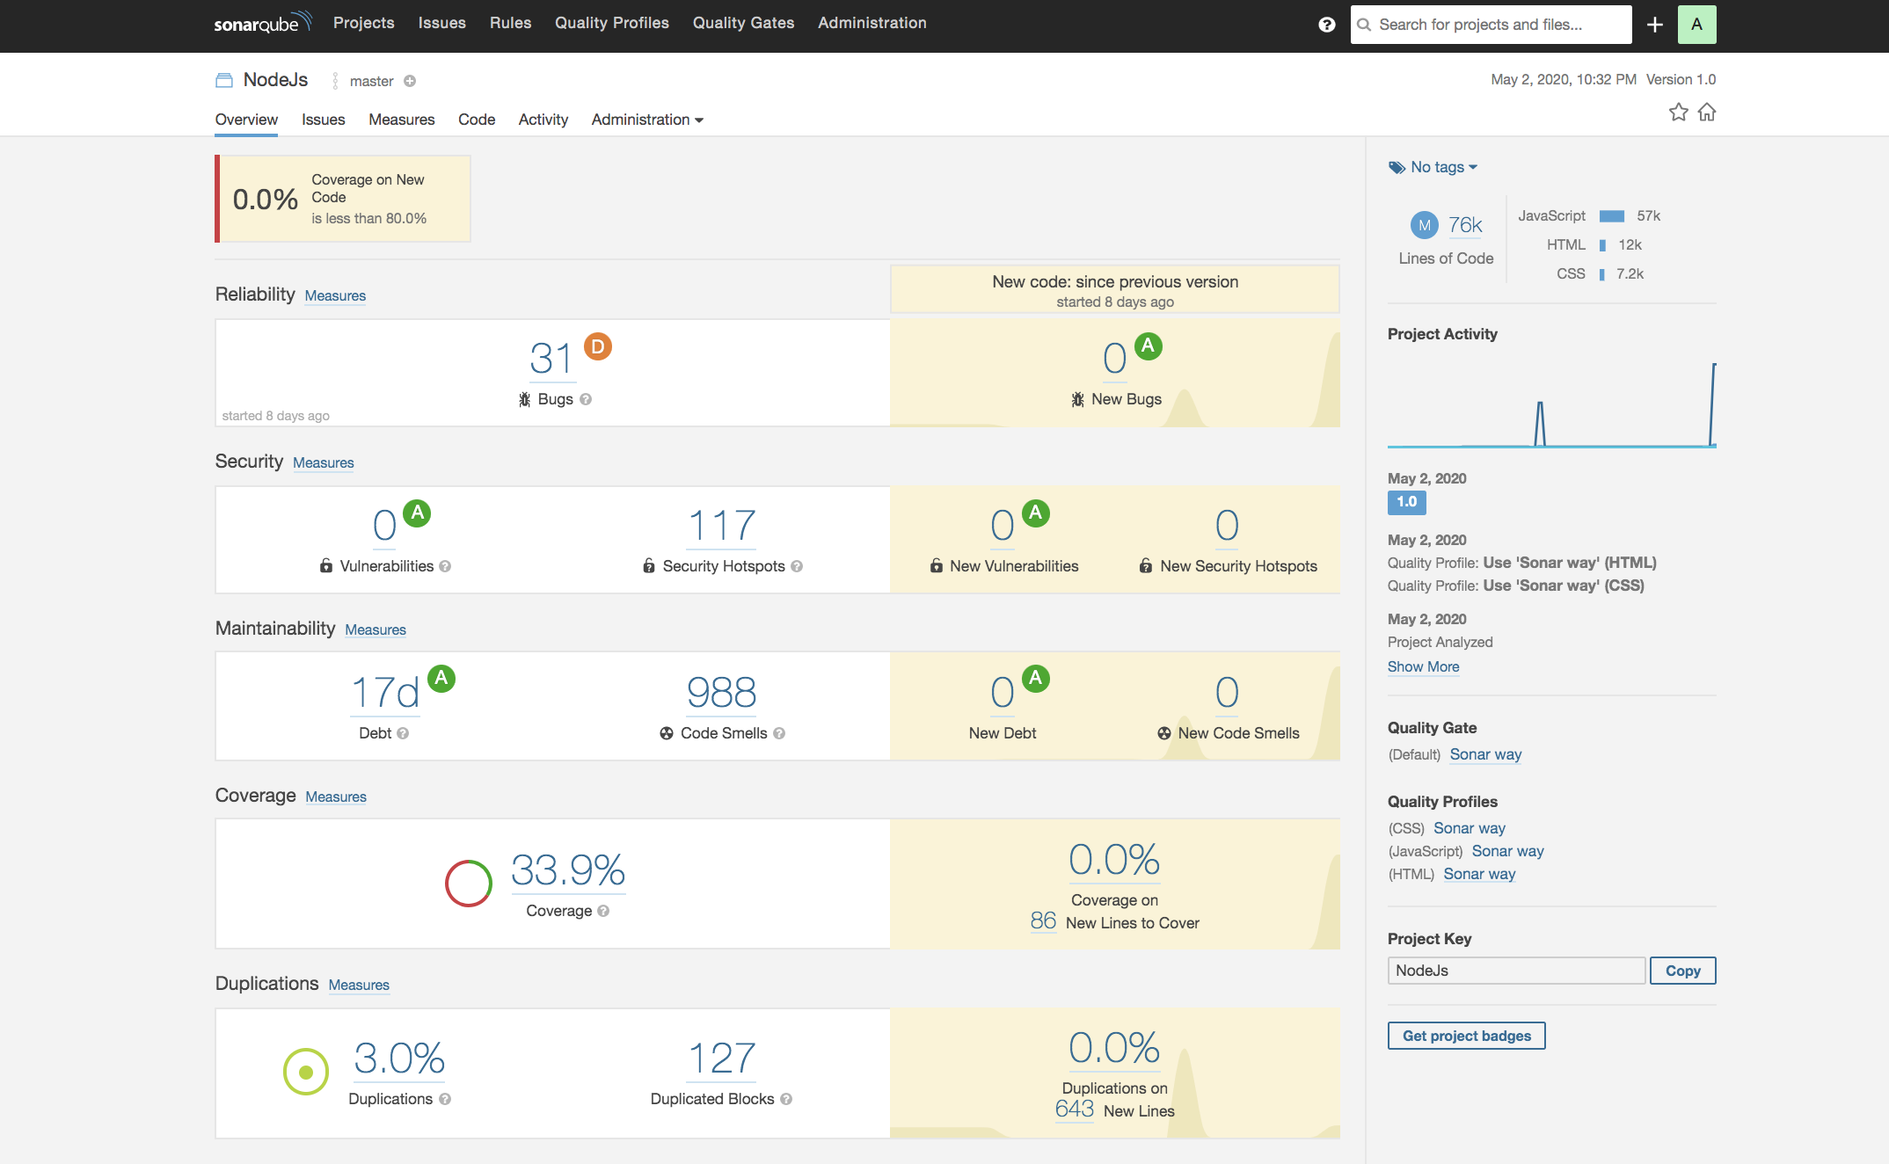
Run Jenkins NodeJs Job : Final Result SonarQube

Slide 5
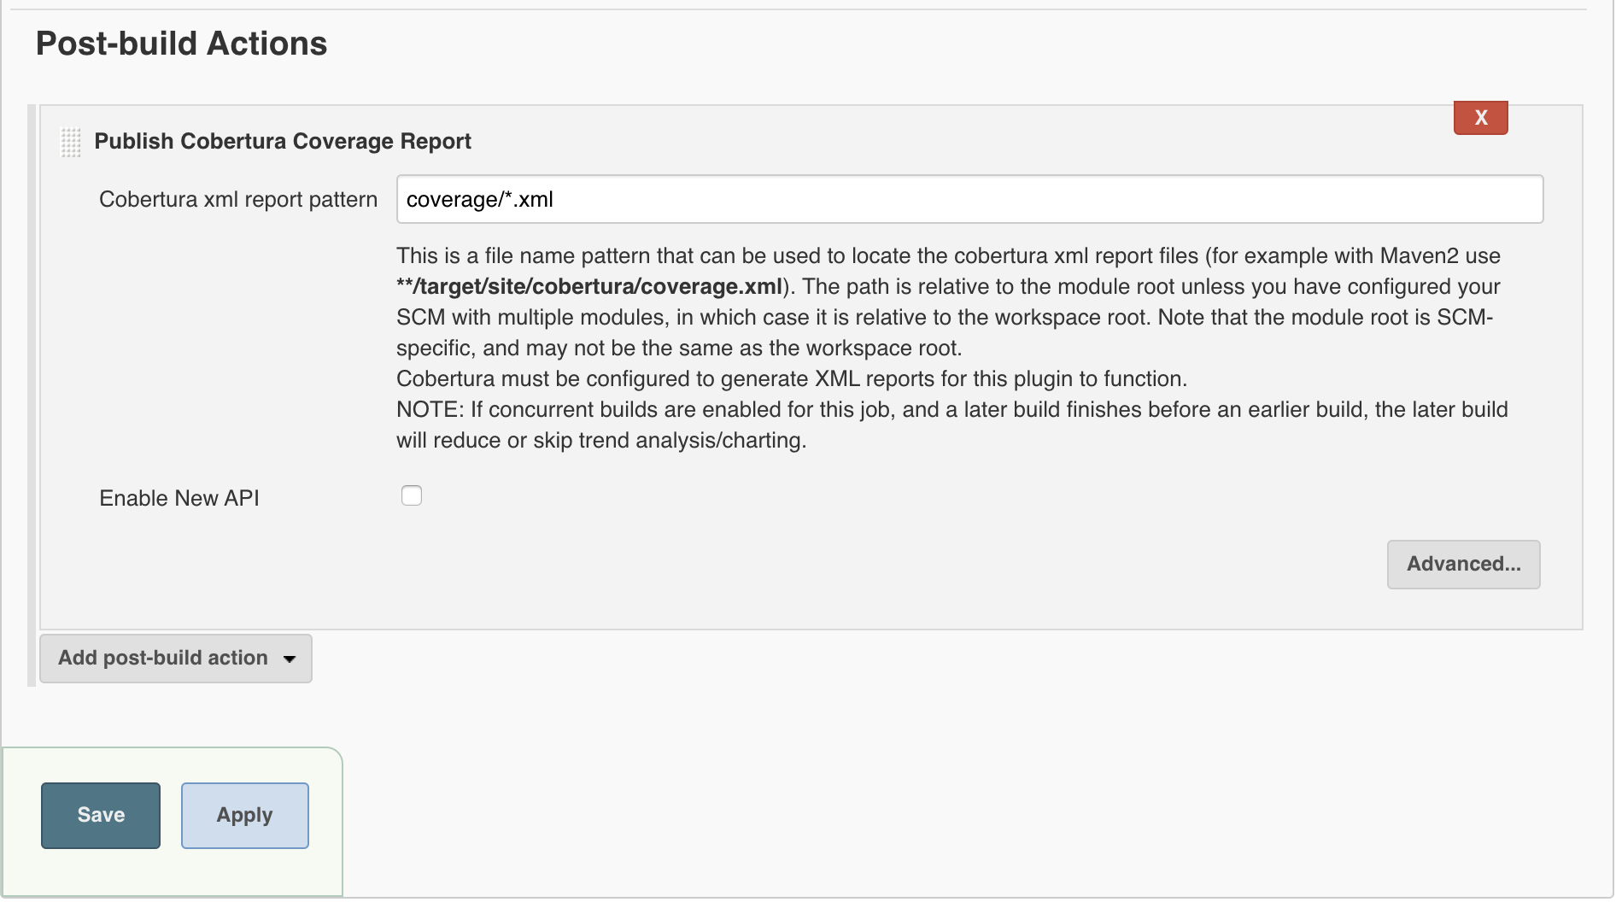
Jenkins coverage Plugin : Cobertura

Slide 6
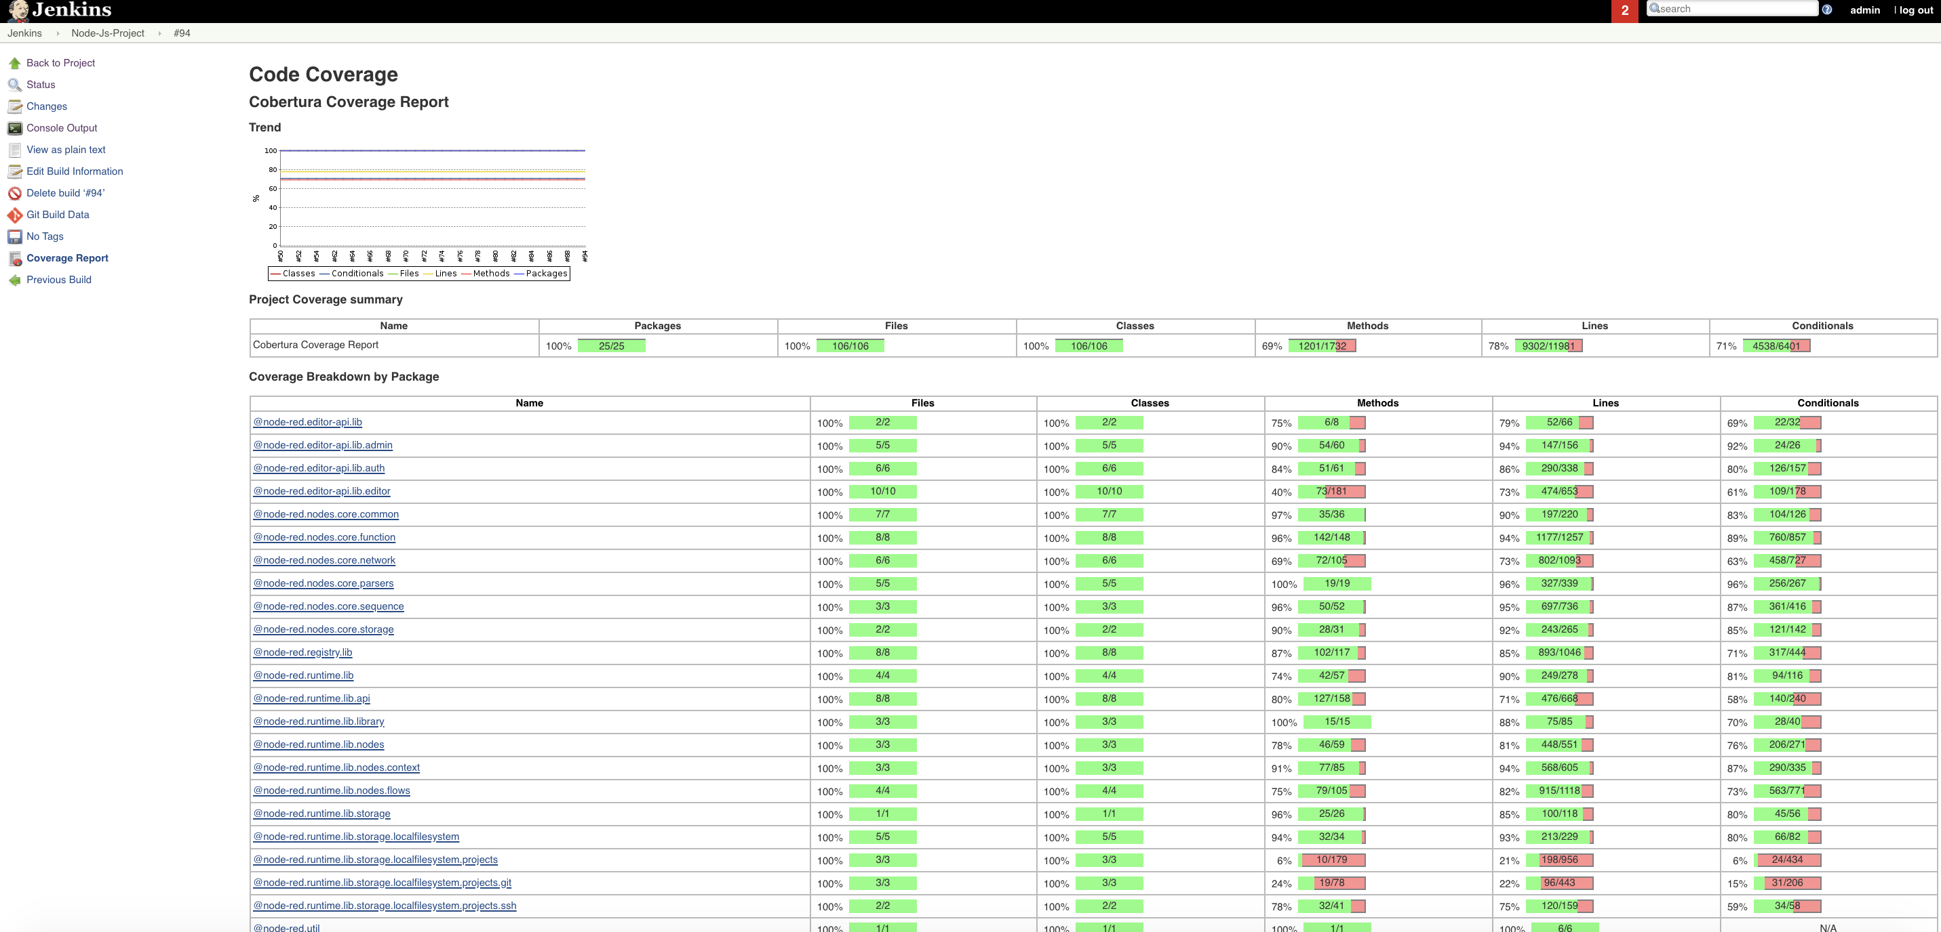
On boarding NodeJs project on Jenkins
Follow the Video & Snapshots for reference

Slide 7
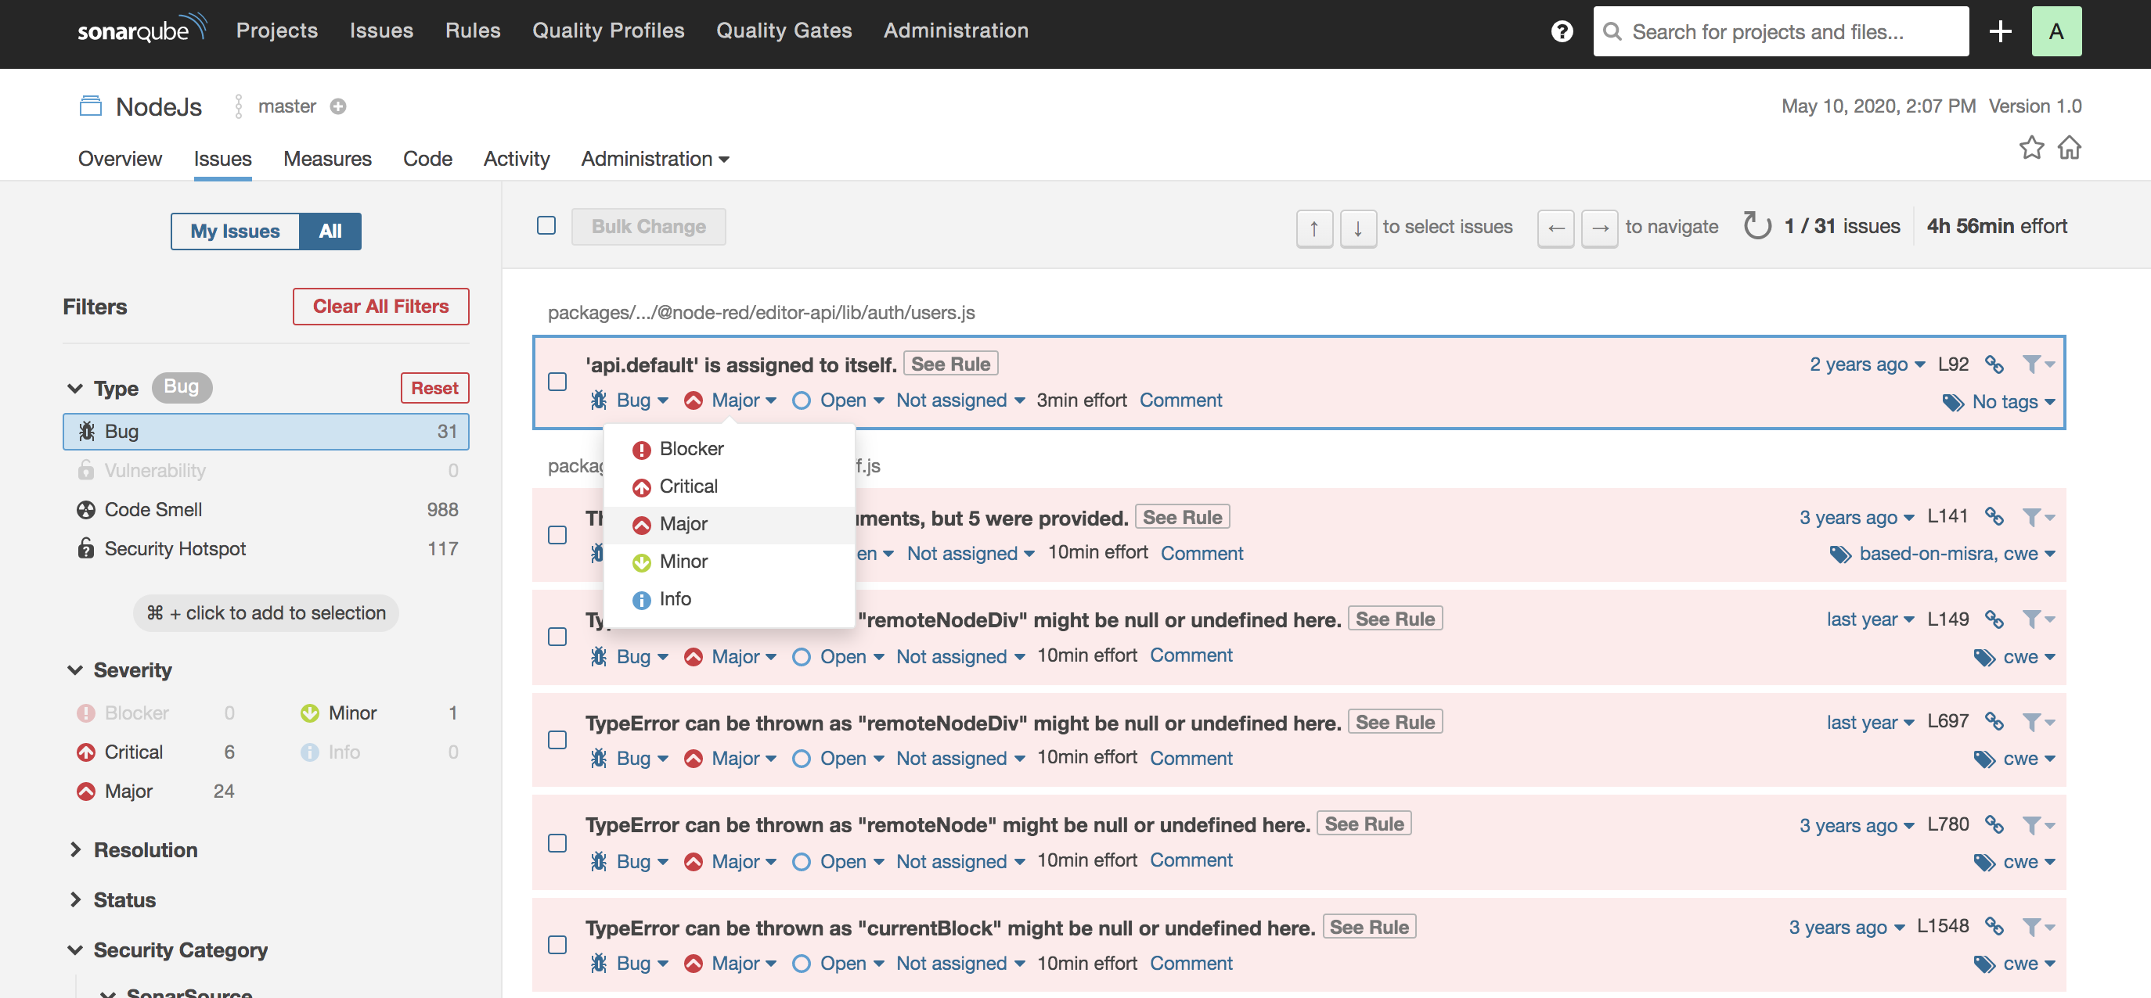
SonarQube : Reliability/Bugs & Security HotSpot analysis

Slide 8
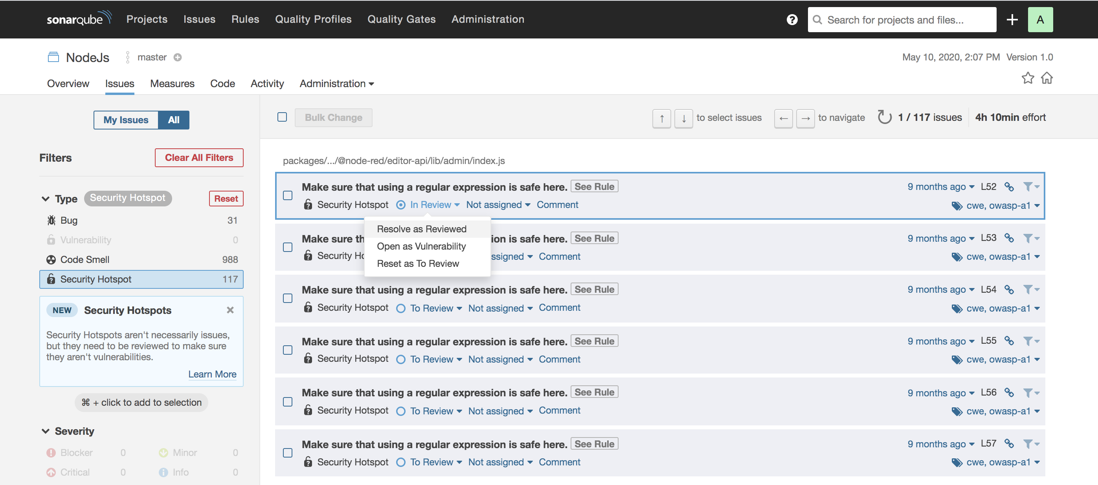
SonarQube : Reliability/Bugs & Security HotSpot analysis

Slide 9
Congrats !!!
NodeJs Project is on boarded successfully.
Git repo for NodeJs: https://github.com/trainmefordevsecops/node-red.git

